Slide 1

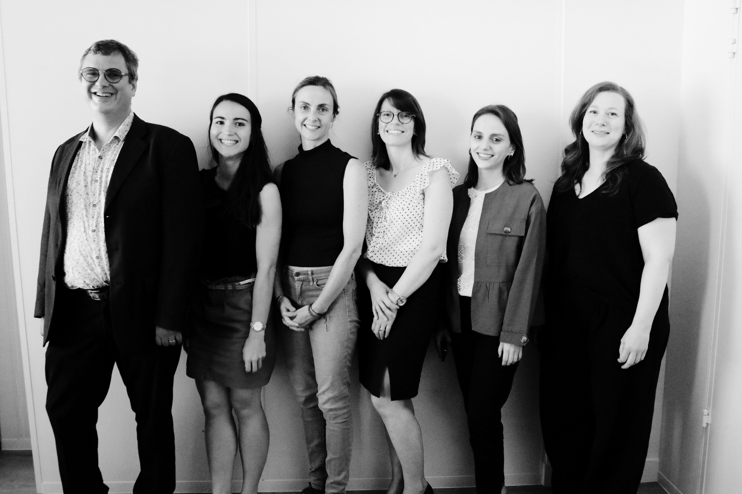


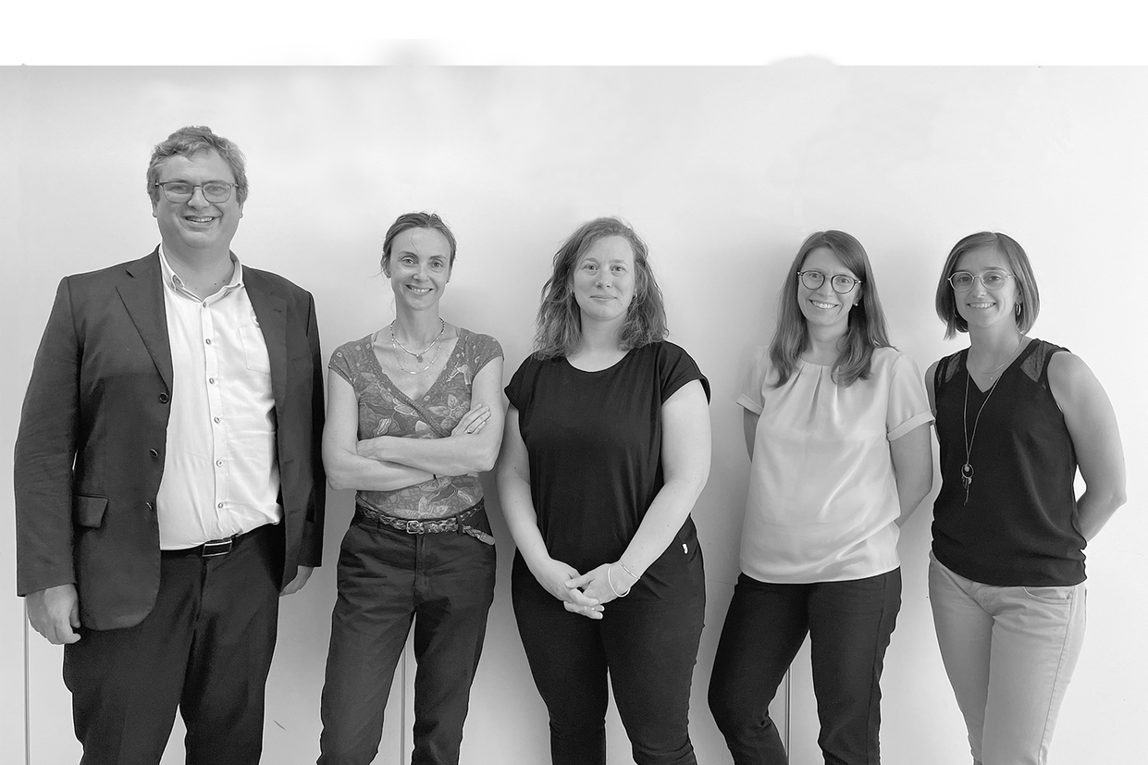



La cellule Europe
Pôle Relations Européennes (PRE)
Guillaume Fusai
Laurence Garric
Aude Raimbault
Géraldine Camilleri
Ivone Alves
Responsable du Pôle Europe
ERC, EIT Health
Cluster Santé (IHI - EDCTP3), mission cancer
EIC Pathfinder
Communication
Département des Ressources Humaines (DRH)
Département des Affaires Financières (DAF)
Morgane Bureau
Marion Di Maria
Actions Marie S. Curie
Aspects Juridiques et Financiers
cellule.europe@inserm.fr
Plan d’action pour la mise en œuvre de la stratégie européenne de l’Inserm

Slide 2

POUR VOUS, UN ENSEMBLE D’ACTEURS POUR RÉALISER VOTRE OBJECTIF HORIZON EUROPE
VOTRE DÉLÉGATION RÉGIONALE
CELLULE EUROPE / SIÈGE
Accompagnement au montage budgétaire et juridique
Gestion financière du projet s’il est sélectionné
Identification de l’instrument pertinent en fonction de votre projet
Vérification de l’adéquation du projet avec l’appel que vous avez ciblé
Analyse des facteurs de succès dans les projets gagnants, conseils d’écriture
Règles de participations
Mise en relation avec lauréats
Statistiques
Relecture (ERC et MSCA)
Accompagnement pour l’oral ERC (oraux blancs avec panélistes et lauréats)
INSERM TRANSFERT
Pour la coordination de projets avec plusieurs partenaires (Cluster Santé, IHI, EDCTP3, ERC PoC, ERC SyG,
MSCADoctoral Networks & Staff Exchanges)
Chef de projet dédié
Planification, structuration, contribution à la rédaction
Organisation administrative
(collecte des données des partenaires, réunions, soumission)
Frais de montage pris en charge par le siège

Slide 3
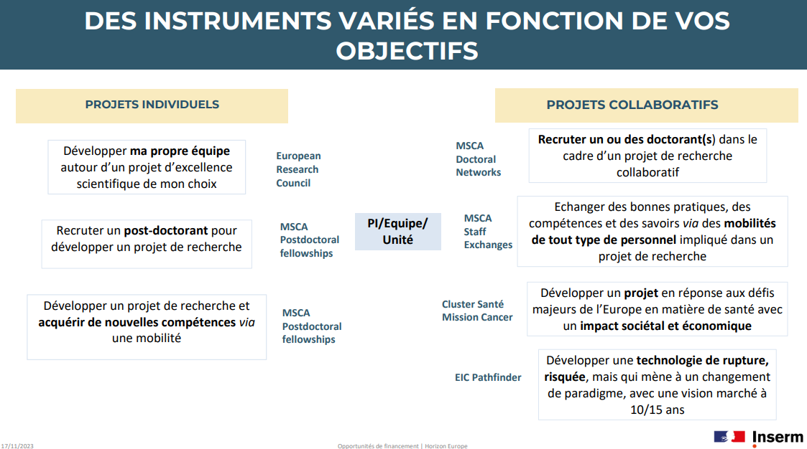

Slide 4

2 principaux AAP Cluster Sante 2025 en Neuro
HORIZON-HLTH-2025-03-ENVHLTH-01-two-stage: The impact of pollution on the development and progression of brain diseases and disorders | RIA | 6 projets financés 6-7 M€/projet
HORIZON-HLTH-2025-03-DISEASE-02-two-stage: Advancing innovative interventions for mental, behavioural and neurodevelopmental disorders | RIA | 7 projets financés 6-8M€/projet
AAP en 2 étapes
Research and Innovation Actions (RIA) → Recherche fondamentale et appliquée, développement et l’intégration de technologie, essais et validation d’un prototype à petite échelle dans un laboratoire ou un environnement simulé
Calendrier prévisionnel :
Adoption officielle du WP 2025 Cluster Santé : Avril 2025 ;
Ouverture officielle des AAP : 22 mai 2025 ;
Deadline AAP 1 étape : 18 septembre 2025
Deadline AAP 2 étapes : 16 avril 2026
Résultats projets financés: Juillet 2026
Lancement des projets: Janvier 2027

Slide 5
HORIZON-HLTH-2025-03-ENVHLTH-01-two-stage: The impact of pollution on the development and progression of brain diseases and disorders
Destination 2 : Living and working in a health-promoting environment:
RIA- 6 projets financés - 6-7 M€/projet
Implication SHS + JRC
Life-long exposure to pollutants in the living and occupational environment = an important risk factor for non-communicable diseases, leading to a variety of serious physical and mental health impacts and causing preventable disease burden with associated elevated economic costs.
Pollution disproportionately impacts certain vulnerable groups (e.g. children and older adults) or groups who are more sensitive or more exposed (workers, populations living in polluted areas) to this type of environmental stressor.
Age is the main risk factor for neurodegenerative diseases, but environmental exposure and lifestyle are important candidates for understanding their aetiology.
“Exposome”, described as the totality of human environmental exposures from pre-conception onwards, represents a major modifiable risk factor for most neurodegenerative diseases and dementia.
The environment is known to be a significant determinant of child health, with increasing evidence that some industrial chemicals are toxic to the development of the human brain. The health impact of many potential neurotoxic chemicals remains unstudied in human populations, including in children. The developing brain is particularly vulnerable to toxic chemical exposures and this sensitivity is likely greatest in utero and throughout early childhood.
Chronic and repeated exposure to pollutants in working environments but also for consumers, has also been associated with increased risk of cognitive impairment and neurodegeneration.

Slide 6
HORIZON-HLTH-2025-03-ENVHLTH-01-two-stage: The impact of pollution on the development and progression of brain diseases and disorders
Expected outcomes:
Scope:
Explore evidence on the causal link between exposure to different pollutants (focusing on specific pollutants or a combination thereof) and the development or progression of neurological, neurodegenerative or neurodevelopmental diseases or disorders.
ICD-11 for Mortality and Morbidity Statistics – Chapters 6 and 8 specifically on neurodevelopmental disorders and neurocognitive disorders (including accelerated cognitive decline) and chronic pain conditions (including accelerated cognitive decline and chronic pain conditions).
Global and EU policies | Preventing and reducing the health impacts of pollution are supported with up-to-date scientific evidence, tools and methodologies
Citizens | More protected by having a better insight into exposure to pollution and its impacts on brain health and adopting health enhancing behaviours;
Public authorities, health stakeholders, the scientific community + society | Have access to FAIR data on the link between pollution and brain health, particular windows of susceptibility to exposure and the impacts of pollution on the general population and vulnerable groups;
Public authorities | Develop adequate evidence-based measures and guidelines to prevent and reduce the negative impacts of pollution in the development of brain disease.
Focus either on neurological, neurodegenerative or neurodevelopmental diseases or disorders/ each of the three focus areas, proposals can address one or several diseases or disorders as relevant for the research action proposed.
Proposals can consider occupational, living and/or social environments and include one or more vulnerable, sensitive or exposed population groups.

Slide 7
HORIZON-HLTH-2025-03-ENVHLTH-01-two-stage: The impact of pollution on the development and progression of brain diseases and disorders
Several of the following activities:
Gain better insights on the pathogenesis and the molecular, genetic and epigenetic pathways and biological mechanisms involved in the onset and progression of disease, considering emerging pollutants, specific windows of susceptibility and adopting, when relevant, a life-course approach. Synergistic neurotoxic effects and realistic doses and duration of exposure should also be considered;
Generate evidence on the impacts of pollution in comorbidities associated to neurodegenerative, neurological or neurodevelopmental diseases and disorders;
Develop and/or validate better in-vivo, in-silico and in-vitro models, instruments and/or methods and take advantage (as applicable) of structural, functional and molecular imaging methods (ex. MRI nuclear imaging), -multi-omics and bioinformatics to study disease causation and evolution, considering among others epigenetic factors and providing better biomarkers for early detection and disease progression;
Apply the exposome framework to advance the understanding of the role of environment on neurogenerative diseases research; elucidating the neuroexposome and emphasizing the brain’s distinctive responses to environmental exposures;
Contribute to the development of health indicators to inform mitigation and prevention measures (incorporating, when relevant, an intersectional approach that considers diverse individual characteristics such as gender, age, disability and socioeconomic and lifestyle factors);
Strengthen the understanding of the causative link between exposure and incidence of disease by taking advantage of well-designed longitudinal studies (considering exposure duration and differences in exposure composition, geographical location and sources), rigorously controlled epidemiologic studies and clinical, real-world and cohort data (building on existing national and international cohorts when available);
Generate evidence on the potential association between the accumulated long-term exposure of workers and consumers to pollutants (including low-level exposure) and neurological and neurodegenerative diseases. The development of neurodevelopmental disorders in children following parental exposure could also be evaluated.

Slide 8
HORIZON-HLTH-2025-03-DISEASE-02-two-stage: Advancing innovative interventions for mental, behavioural and neurodevelopmental disorders
Destination 3 -Tackling diseases and reducing disease burden
RIA- 7 projets financés - 6-8 M€/projet
Implication SHS + SMEs + network with the European Partnership for Brain Health
Mental, behavioural and neurodevelopmental disorders, that include for ex severe depression, anxiety, schizophrenia, psychosis, post-traumatic stress disorder (PTSD), addictive behaviours (drugs , alcohol, gaming and others), obsessive-compulsive disorder, eating disorders and autism spectrum disorder are a high burden for patients, health systems and society, and remain unmet medical needs.
Disorders→ ICD-11 - World Health Organization (WHO)→ Chapter 6: ‘Mental, behavioural or neurodevelopmental disorders’.
Rare diseases are excluded
Scope:
More innovative, safer and more effective therapeutic and relapse-preventing solutions based on active substances are required
Other non-invasive multidisciplinary and/or transdiagnostic approaches (e.g. neurostimulation, neuroimaging, digital, non-pharmaceutical, psychotherapy, psychosocial) should be further developed to complement the therapeutic and relapse prevention solutions
Improve health outcomes, self-determination, autonomy and quality of life in the long-term.

Slide 9
HORIZON-HLTH-2025-03-DISEASE-02-two-stage: Advancing innovative interventions for mental, behavioural and neurodevelopmental disorders
Scientific and clinical communities | Make effective use of state-of-the-art knowledge, data, technologies, tools, methods, best practices, and trainings to underpin and complement the development of innovative interventions aimed at achieving a lasting benefit. Benefit from the exchange of data, knowledge and best practices, thereby strengthening their collaboration and building knowledge and care networks in the EU, the Associated Countries and beyond. Make wide use of relevant databases and/or integrate them with existing infrastructures for storage and sharing of collected data according to FAIR principles, thereby encouraging further use of the data.
Policymakers, funders, scientific and clinical communities, patient organisations, regulators | Informed of the research advances made and the requirements for a widespread implementation of the innovative therapeutic interventions and complementary approaches.
Patients and caregivers | Ensuring that their needs are catered for, with the aim of tangibly benefitting from the interventions.
Expected outcomes:

Slide 10
HORIZON-HLTH-2025-03-DISEASE-02-two-stage: Advancing innovative interventions for mental, behavioural and neurodevelopmental disorders
Most of the following aspects:
Perform rigorous clinical studies into the safety and efficacy of the innovative interventions and their mode of administration, ensuring adequate cohorts/sample sizes with adequate representation of the patient population, including in terms of age, sex and ethnicity.
Through the clinical studies, gain further insight into the mechanism(s) of action of the innovative therapies and complementary approaches. Could entail analyses of imaging (e.g. MRI, ultrasound, nuclear imaging), as well as physiological, molecular, biochemical or omics signatures revealing potential perturbations prior to the intervention and recovery thereafter and it could lead to the development of surrogate endpoints. → more personalised interventions and approaches.
Use and/or develop technologies, including digital ones (ex: generative AI, wearable technologies) to help implement and monitor the long-term efficacy of the intervention(s), as well as manage the disorder and/or monitor their progression (e.g. with unobtrusive technologies suitable for patient monitoring at home and in real-world conditions), whilst also ensuring they are bias-free, inclusive, and ethically sound)
Exploit existing data, biobanks, registries and/or cohorts, together with the generation of new data (managed in line with FAIR principles
Engage all relevant stakeholders (especially patients and patients’ representatives for the disorder, caregivers, clinicians, counsellors, regulators, etc.) to design end-user optimised interventions, applying gender-sensitive and intersectional approaches.
Advance research by leveraging already existing and emerging state-of-the-art research infrastructures (e.g. ECRIN, EATRIS, EBRAINS, EuroBioImaging, BBMRI, European Genomic Data Infrastructure)
Engage with national public health authorities and regulators to ensure a robust development pathway and further uptake of the intervention
As proposals under this topic are expected to include clinical studies, the use of the template is strongly encouraged.

Slide 11


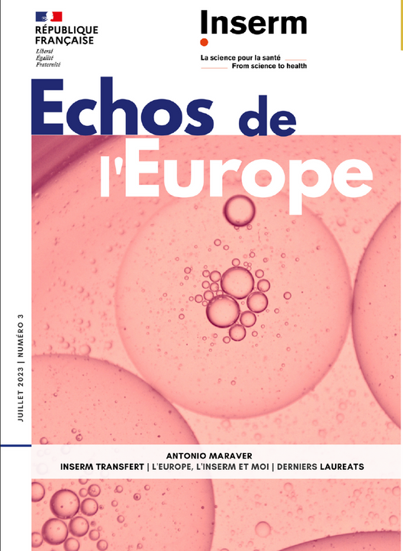
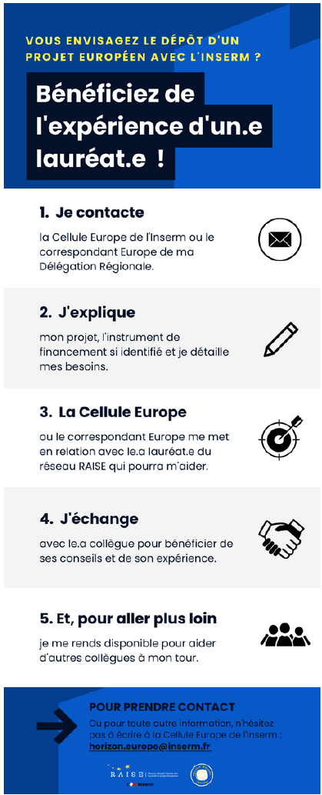

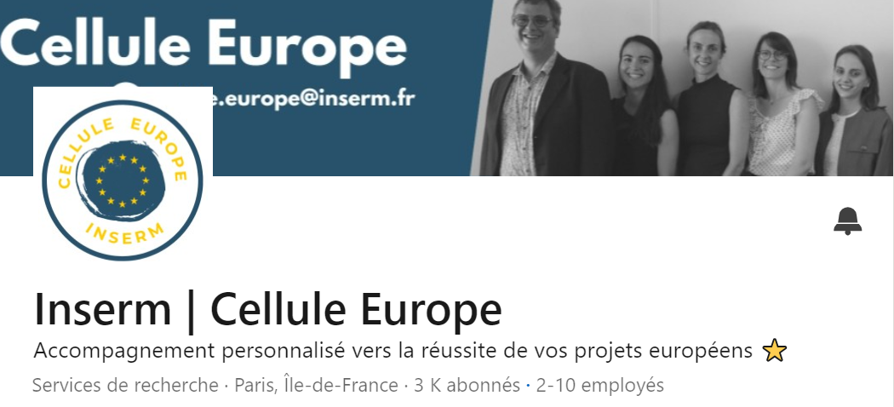
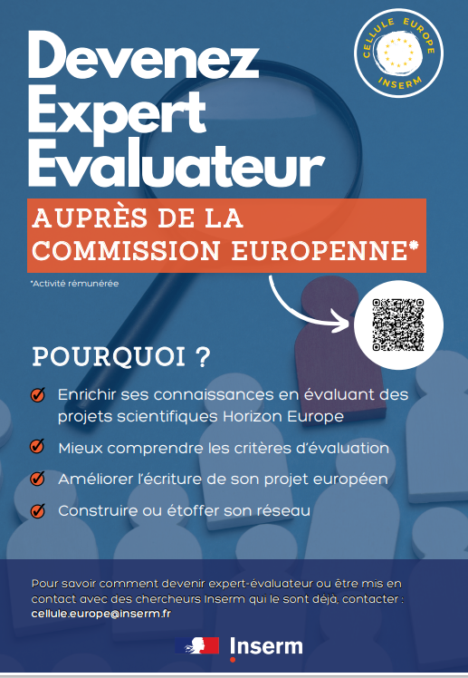
ACTIONS COMMUNICATION ET VISIBILITé
Replay – Table ronde – Devenir expert-évaluateur auprès de la CE (juin 2024)
Work as an expert | EU Funding & Tenders Portal (europa.eu)
https://www.calameo.com/books/005154450893789c14fb7
Horizon Europe : quels outils pour financer mon projet - Inserm pro

